Slide 1
2x2 Contingency Table (Crosstab)
 | Outcome + | Outcome -
Exposure + | a | b
Exposure - | c | d
This order is important!!
Notes:
crosstab_01

Slide 2
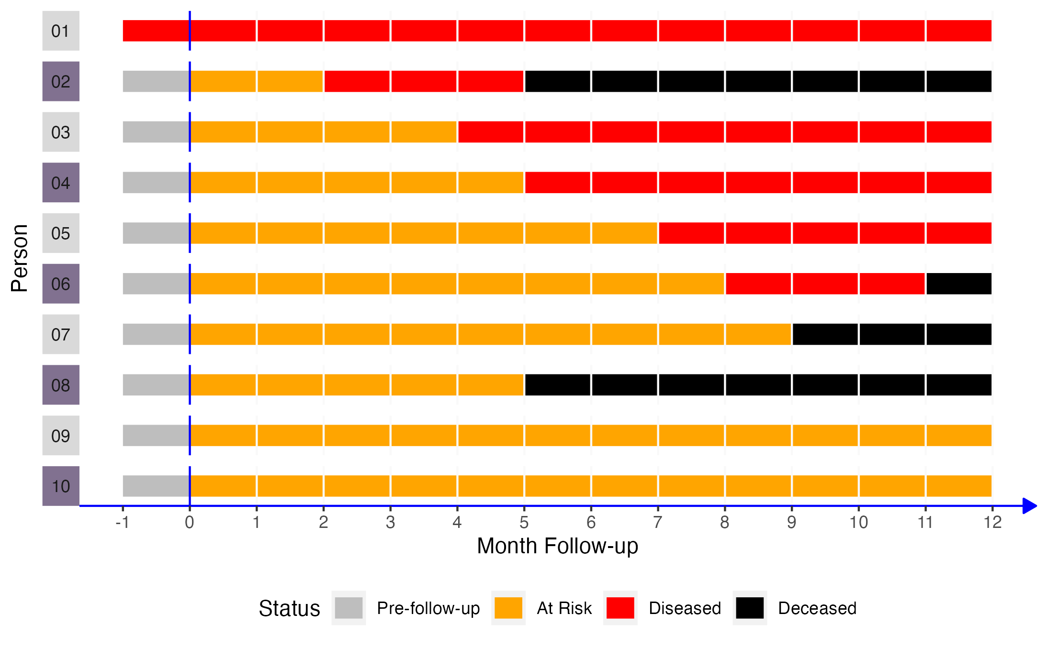
 | Disease + | Disease -
Exposure + | a | b
Exposure - | c | d
Notes:
crosstab_02

Slide 3
 | Disease + | Disease -
Exposure + | 3 | 2
Exposure - | 3 | 2
Notes:
crosstab_03

Slide 4
2x2 Contingency Table (Crosstab)
 | Outcome + | Outcome - | Row Total
Exposure + | a | b | a+b
Exposure - | c | d | c+d
Column Total | a+c | a+c | a+b+c+d
Table Margins
Marginal Totals
Notes:
crosstab_04

Slide 5
2x2 Contingency Table (Crosstab)
 | Outcome + | Outcome - | Row Total
Exposure + | 3 | 2 | 5
Exposure - | 3 | 2 | ?
Column Total | ? | ? | ?
Notes:
crosstab_05

Slide 6
2x2 Contingency Table (Crosstab)
 | Outcome + | Outcome - | Row Total
Exposure + | 3 | 2 | 5
Exposure - | 3 | 2 | 5
Column Total | 6 | 4 | 10
Notes:
crosstab_06

Slide 7
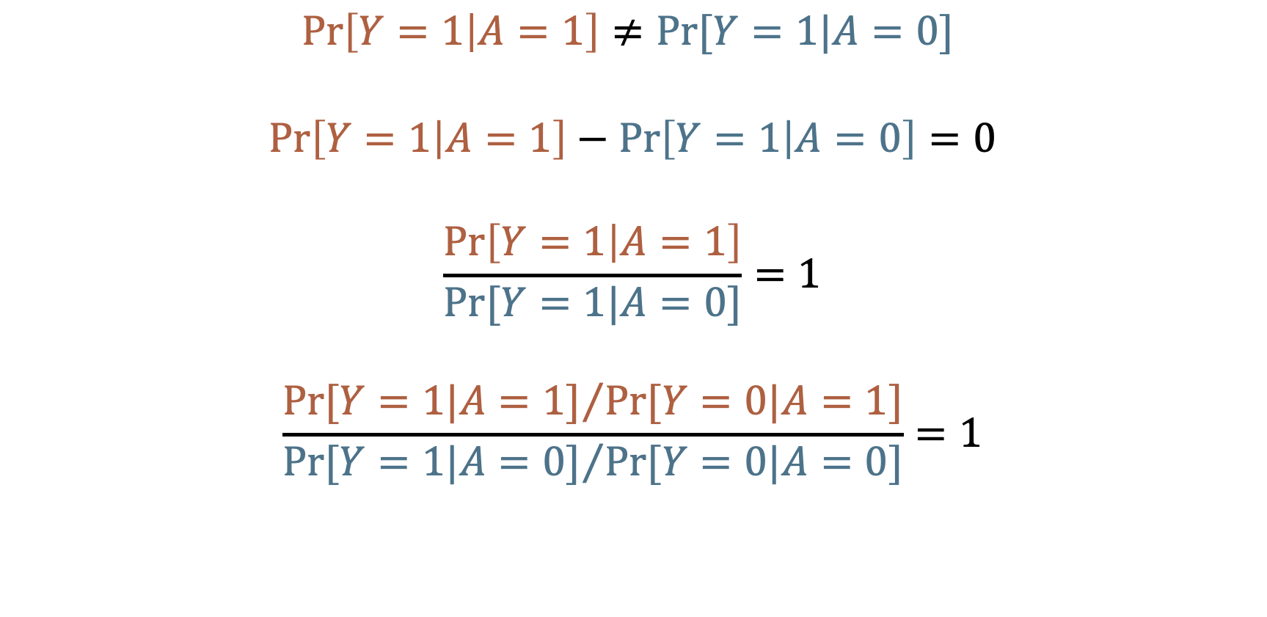
No Association (Independence)
$$\operatorname{Pr}\left[Y=1 | A=1\right]≠Pr⁡[Y=1|A=0]$$
$$\operatorname{Pr}\left[Y=1 | A=1\right]−\operatorname{Pr}\left[Y=1 | A=0\right]=0$$
$$\frac{\operatorname{Pr}\left[Y=1 | A=1\right]}{Pr⁡[Y=1|A=0]}=1$$
$$\frac{{Pr⁡[Y=1|A=1]}/{Pr⁡[Y=0|A=1]}}{{Pr⁡[Y=1|A=0]}/{Pr⁡[Y=0|A=0]}}=1$$
Incidence Proportion difference
Null = 0
Incidence Proportion ratio
Null = 1
Incidence odds ratio
Null = 1
Notes:
independence

Slide 8
Incidence Proportion Difference
$$\operatorname{Pr}\left[Y=1 | A=1\right]−\operatorname{Pr}\left[Y=1 | A=0\right]=…$$
$$\operatorname{Pr}\left[Y=1 | A=1\right]<\operatorname{Pr}\left[Y=1 | A=0\right]$$
$$\operatorname{Pr}\left[Y=1 | A=1\right]>\operatorname{Pr}\left[Y=1 | A=0\right]$$
Null = 0
-1, … -0.7, -0.8, -0.9
0.1, 0.2, 0.3, … 1
Association
No Association
Association
Notes:
incidence_proportion_difference_null

Slide 9

Incidence Proportion Ratio
$$\frac{\operatorname{Pr}\left[Y=1 | A=1\right]}{Pr⁡[Y=1|A=0]}=…$$
$$\operatorname{Pr}\left[Y=1 | A=1\right]<\operatorname{Pr}\left[Y=1 | A=0\right]$$
$$\operatorname{Pr}\left[Y=1 | A=1\right]>\operatorname{Pr}\left[Y=1 | A=0\right]$$
Null = 1
0, … 0.7, 0.8, 0.9
1, 2, 3, … Inf
Association
No Association
Association
Notes:
incidence_proportion_ratio_null

Slide 10
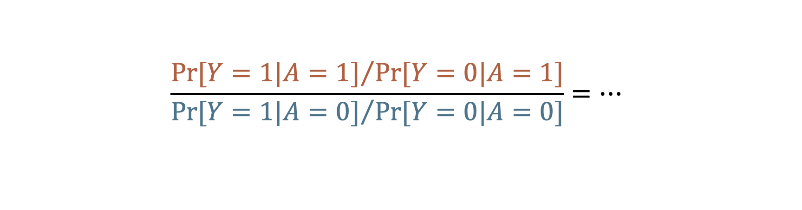
Odds Ratio
$$\frac{{Pr⁡[Y=1|A=1]}/{Pr⁡[Y=0|A=1]}}{{Pr⁡[Y=1|A=0]}/{Pr⁡[Y=0|A=0]}}=…$$
$$\operatorname{Pr}\left[Y=1 | A=1\right]<\operatorname{Pr}\left[Y=1 | A=0\right]$$
$$\operatorname{Pr}\left[Y=1 | A=1\right]>\operatorname{Pr}\left[Y=1 | A=0\right]$$
Null = 1
0, … 0.7, 0.8, 0.9
1, 2, 3, … Inf
Association
No Association
Association
Notes:
odds_ratio_null

Slide 11
Measures of Association
Absolute Measures
Differences
Relative Measures
Ratios
Proportions
Odds
Rates
Proportions
Odds
Rates
Source: Szklo M, Nieto FJ. Epidemiology: Beyond the Basics. Jones & Bartlett Learning; 2019.
Notes:
measures_of_association_tree_01

Slide 12
Measures of Association
“Measures based on absolute differences are often preferred when public health or preventive activities are evaluated, as their main goal is often an absolute reduction in the risk of an undesirable outcome.”
Absolute Measures
Differences
Relative Measures
Ratios
Proportions
Odds
Rates
Proportions
Odds
Rates
Source: Szklo M, Nieto FJ. Epidemiology: Beyond the Basics. Jones & Bartlett Learning; 2019.
Notes:
measures_of_association_tree_02

Slide 13
Measures of Association
“In contrast, etiologic studies that are searching disease determinants (causes) usually rely on relative differences in the occurrence of discrete outcomes.”
Absolute Measures
Differences
Relative Measures
Ratios
Proportions
Odds
Rates
Proportions
Odds
Rates
Source: Szklo M, Nieto FJ. Epidemiology: Beyond the Basics. Jones & Bartlett Learning; 2019.
Notes:
measures_of_association_tree_03

Slide 14
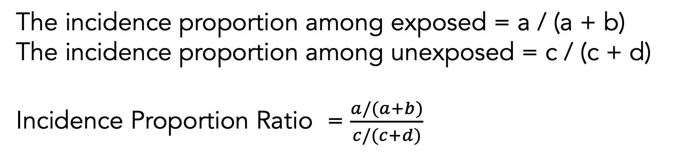
Incidence Proportion Ratio
 | Outcome + | Outcome - | Row Total
Exposure + | a | b | a+b
Exposure - | c | d | c+d
Column Total | a+c | a+c | a+b+c+d
The incidence proportion among exposed = a / (a + b)
The incidence proportion among unexposed = c / (c + d)
Incidence Proportion Ratio = $\frac{a/(a+b)}{c/(c+d)}$
Notes:
incidence_proportion_ratio_crosstab

Slide 15
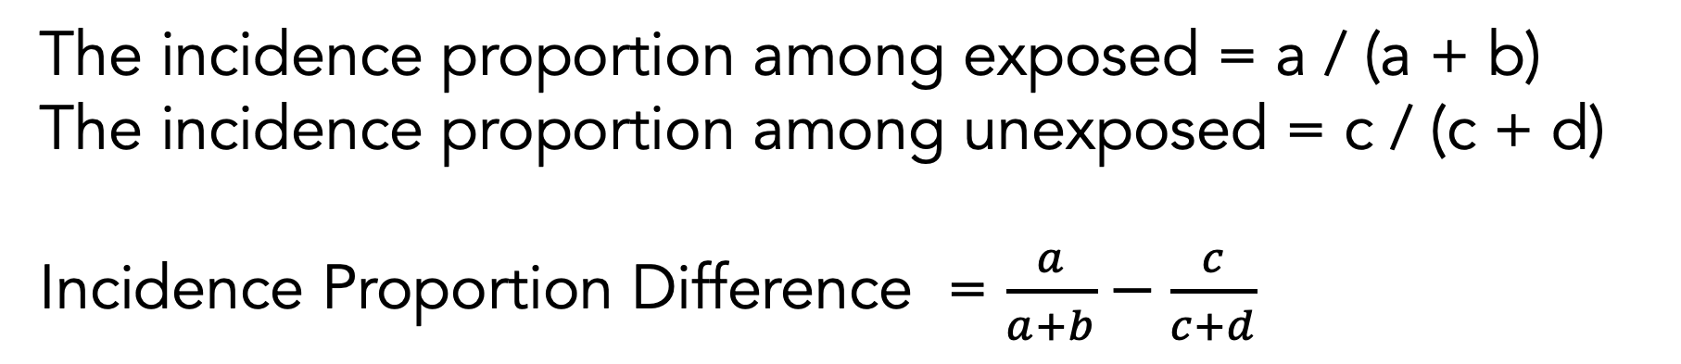
Incidence Proportion Difference
 | Outcome + | Outcome - | Row Total
Exposure + | a | b | a+b
Exposure - | c | d | c+d
Column Total | a+c | a+c | a+b+c+d
The incidence proportion among exposed = a / (a + b)
The incidence proportion among unexposed = c / (c + d)
Incidence Proportion Difference = $\frac{a}{a+b}−\frac{c}{c+d}$
Notes:
incidence_proportion_difference_crosstab

Slide 16
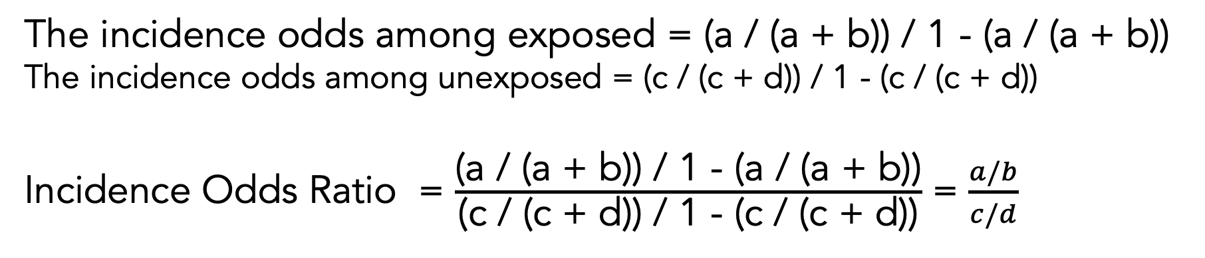
Incidence Odds Ratio
 | Outcome + | Outcome - | Row Total
Exposure + | a | b | a+b
Exposure - | c | d | c+d
Column Total | a+c | a+c | a+b+c+d
The incidence odds among exposed = (a / (a + b)) / 1 - (a / (a + b))
The incidence odds among unexposed = (c / (c + d)) / 1 - (c / (c + d))
Incidence Odds Ratio = $\frac{\text{(}\text{a}\text{ / (}\text{a}\text{ + }\text{b}\text{)) / 1 − (}\text{a}\text{ / (}\text{a}\text{ + }\text{b}\text{))}}{\text{(}\text{c}\text{ / (}\text{c}\text{ + }\text{d}\text{)) / 1 − (}\text{c}\text{ / (}\text{c}\text{ + }\text{d}\text{))}}$ = $\frac{a/b}{c/d}$
Notes:
incidence_odds_ratio_crosstab

Slide 17


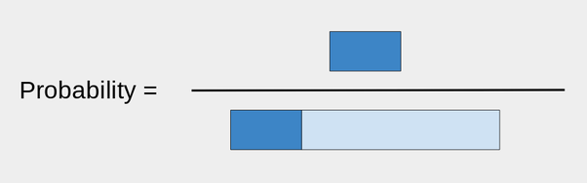
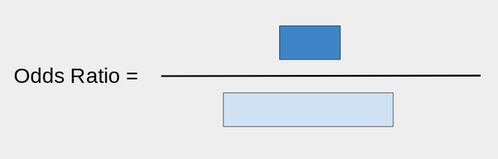
Odds ratio
First take a bar of length 1:
That will be the portion of what did not make it.
Now, take a bar of length r, where r is your ratio. For example, if r was 0.3, I would attach it like so:
The dark blue is the ones that did make it.
Notes:
odds_ratio_and_probability

